Slide 1
Electrocardiography

Slide 2
ECG
It is the procedure of recording the electrical activity of the heart. The electrode combination records the difference of potential difference at two sites on the body. The potential differences are produced due to the electrical activity of the heart.
Electrocardiograph is the machine
Electrocardiogram is the record
The characteristic shape and timing of the ECG waves are due to the spread of wave of depolarization and repolarization associated with each heart beat.

Slide 3
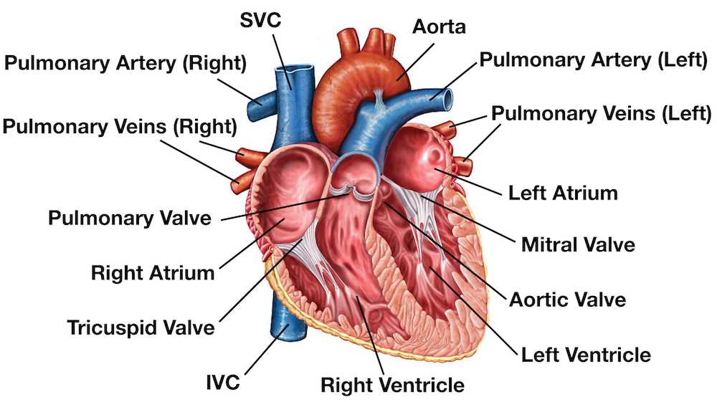

Slide 4
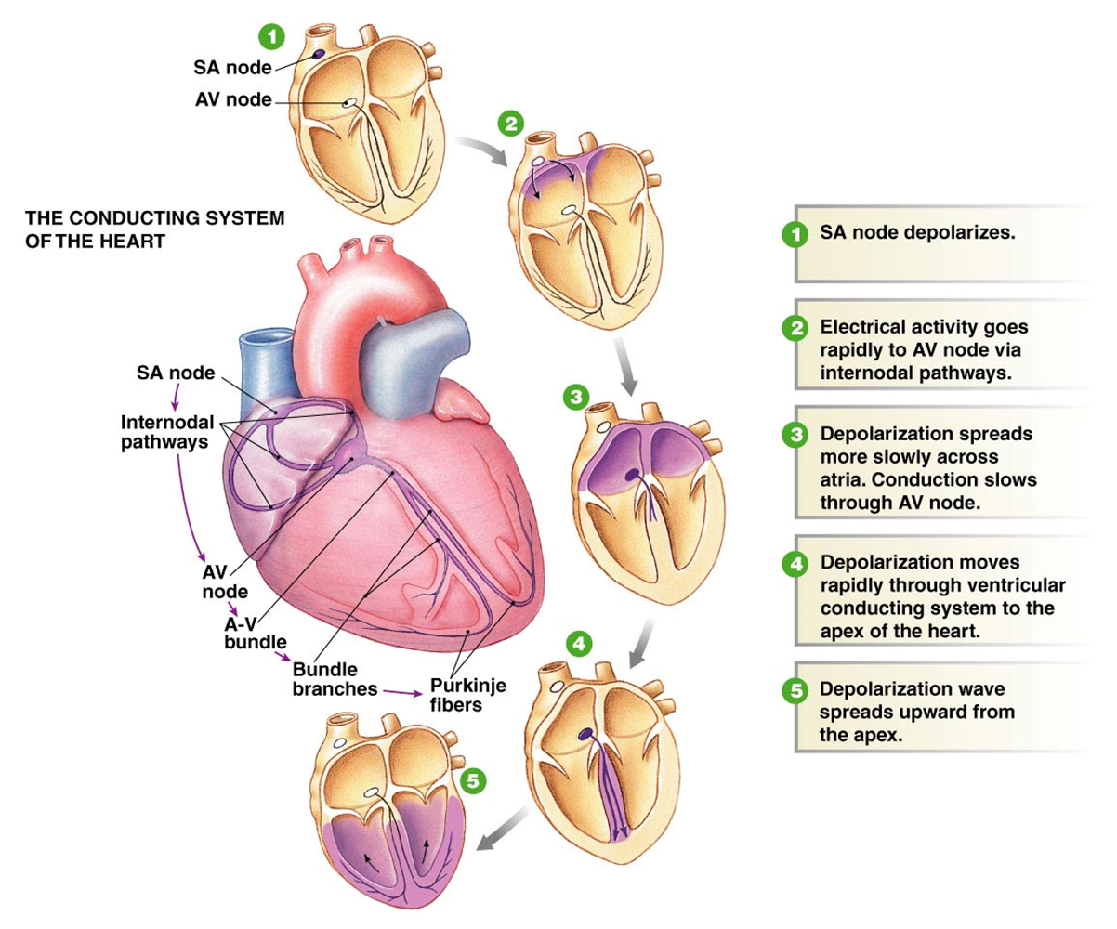
HEART DISEASE

Slide 5
Functions is of the heart & blood vessels
the heart is an essential pumping organ in the cardiovascular system where the right heart pumps deoxygenated blood (returned from body tissues) to the lungs for gas exchange, while the left heart pumps oxygenated blood (returned from the lungs) to tissues cells for sustaining cellular respiration.
Attached to the heart is blood vessels that transport blood in various circulation pathways- pulmonary blood vessels transport blood between the heart and the lungs, and systemic blood vessels transport blood between the heart and body tissues.

Slide 6
Heart chambers
hollow cavities within the heart for containing blood.
Two smaller chambers called atrium are near the base, and two larger chambers called ventricle are close to the apex.
Right atrium (RA) after receiving deoxygenated blood from body tissues through the superior and inferior vena cava, pumps the blood into the right ventricle (RV) via the right atria ventricular orifice. RV then pumps the blood to the lungs for gas exchange, through the pulmonary trunk and arteries.
Left atrium (LA) after receiving oxygenated blood from the lungs through the pulmonary veins, pumps the blood into the left ventricle (LV) via the left atria ventricular orifice.

Slide 7
LV then pumps the blood to the body tissues for supplying oxygen to every body cell, through the aorta
RA and LA are separated by a central heart wall called interatrial septum, while RV and LV are separated by interventricular septum.
LV has a thicker myocardium layer (for stronger contractions) and contains rough ridges called trabeculae carneae (for containing a larger blood volume in exercising conditions).

Slide 8
How does the ECG look like?

Slide 9
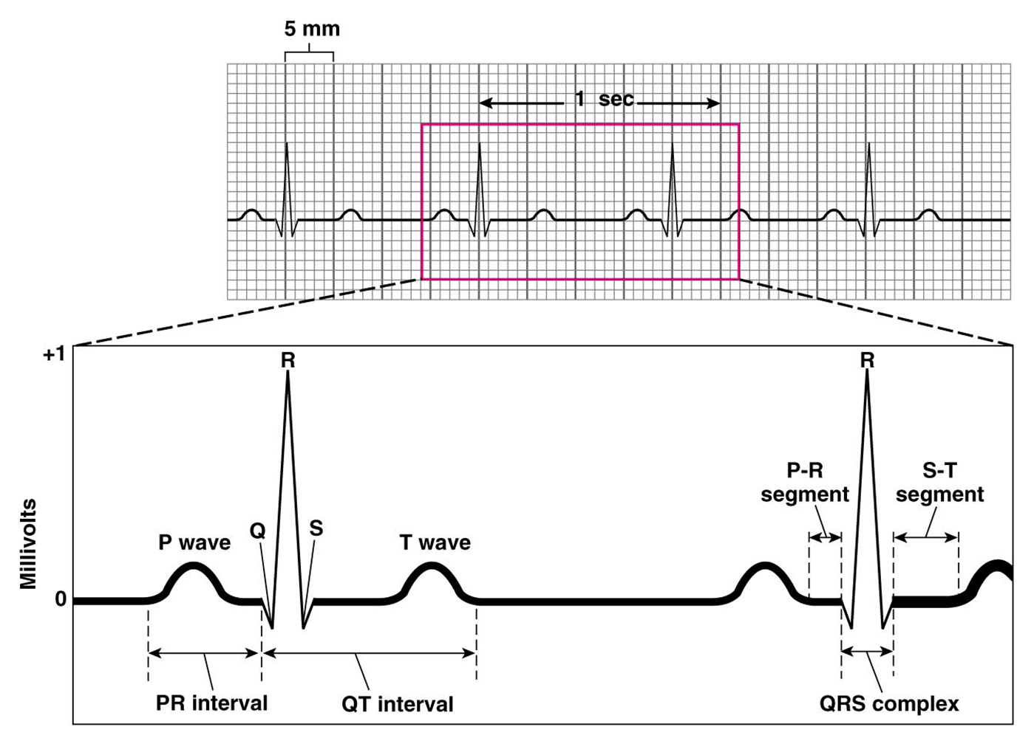

Slide 10
Electrocardiogram waves
P-wave – depolarization of atria
Atria begin contracting about 25msec after the start of the p-wave
QRS-complex – ventricular depolarization
Ventricles begin contracting shortly after the peak of the R wave
T-wave – ventricular repolarization

Slide 11
Electrocardiogram intervals/segments
Segments – extend from the end of one wave to the start of another
P-R interval: start of atrial depolarization to start of QRS
Q-T interval: time required for ventricles to undergo a single cycle of depolarization and repolarization; measured from end of P-R to end of T

Slide 12
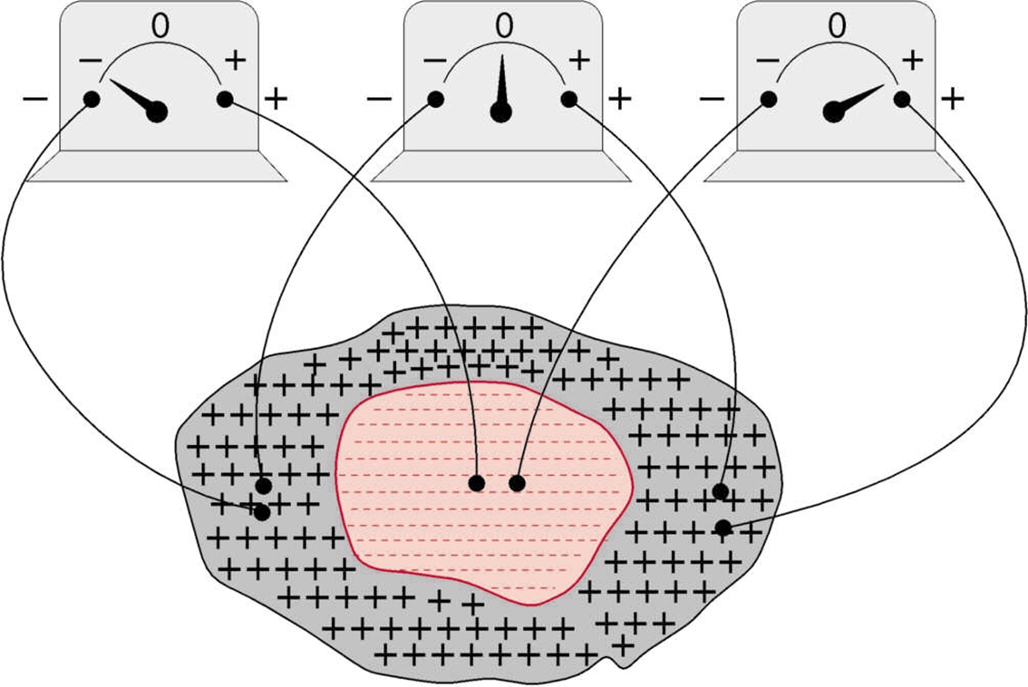
Instantaneous potentials developed on the surface of a cardiac muscle mass

Slide 13
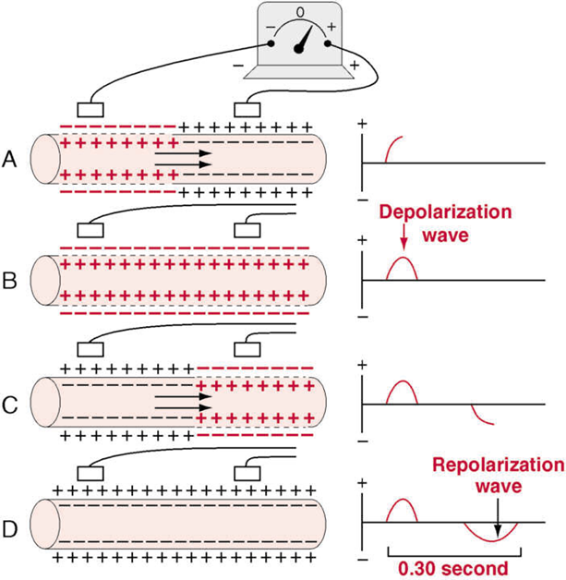
Recording depolarization and repolarization waves

Slide 14
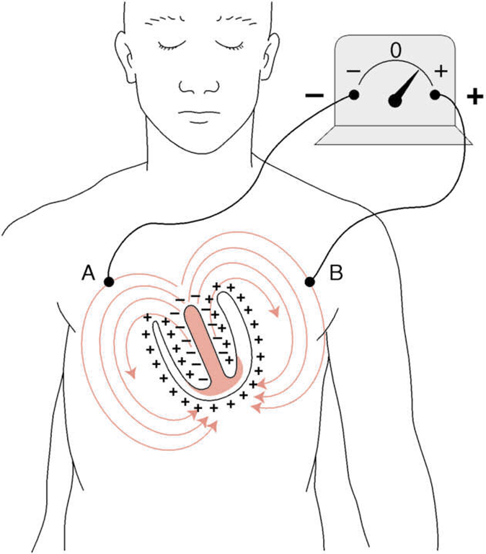
Flow of current in the chest around partially depolarized ventricles

Slide 15
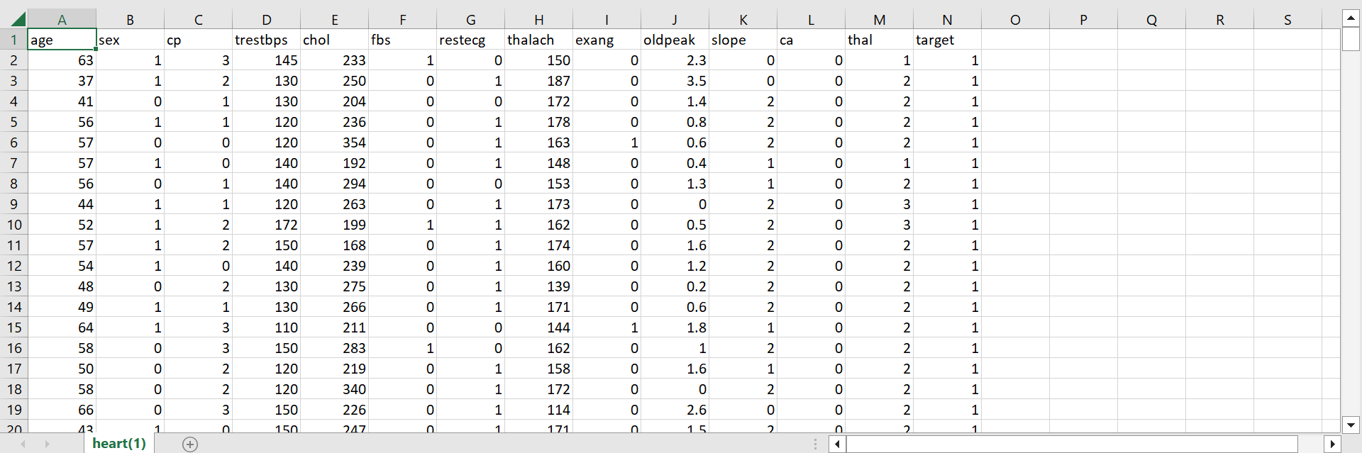
Prediction on Heart Disease Using Machine Learning
DATASET ON HEART DISEASE

Slide 16
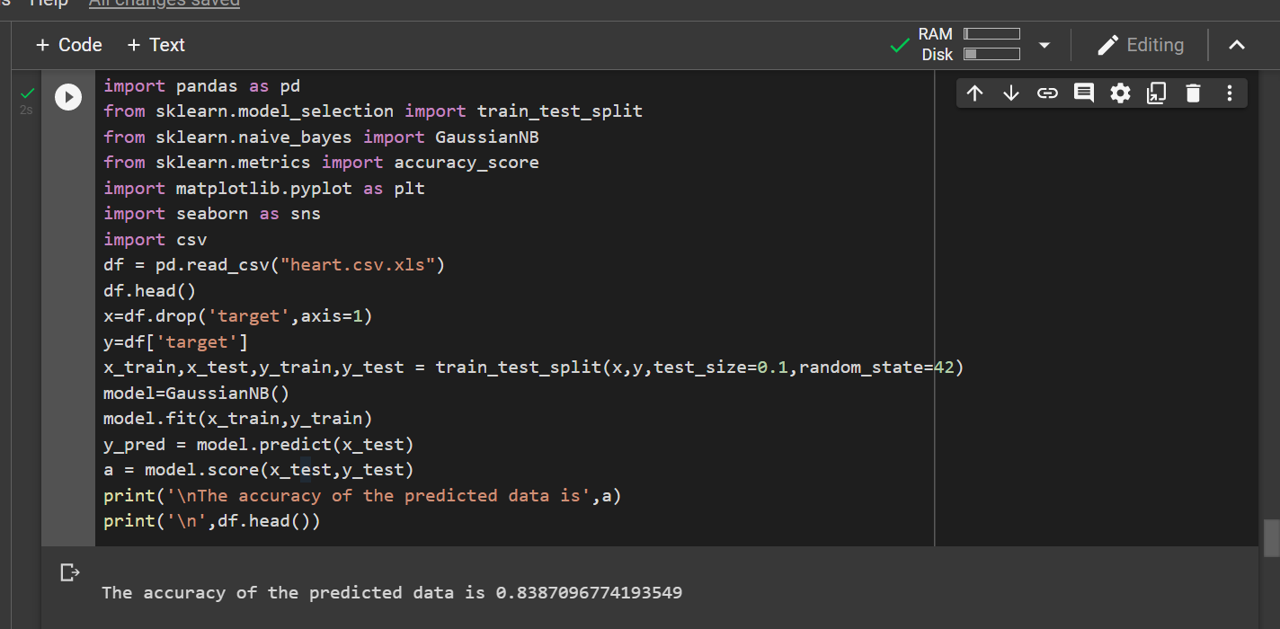

Slide 17
Electroencephalogram

Slide 18
EEG
Introduction
The electroencephalogram (EEG) is a widely used non-invasive method for monitoring the brain. It is based upon placing metal electrodes on the scalp which measure the small electrical potentials that arise outside of the head due to neuronal action within the brain. Its key benefits compared to other brain imaging techniques are that it has a very high time resolution – able to track events within the brain with millisecond accuracy – and that it is in principle portable allowing real-world neuroimaging to be performed outside of clinical and lab environments. As a result it is a very widely used sensing modality for a range of health and wellbeing applications ranging from epilepsy diagnosis to emotional monitoring

Slide 19
Typical Signals
The EEG signal that arises on the scalp is measured as a voltage in the time domain, with a wide number of potential signal morphologies present. Figure 2.1 shows some example waveforms, although a small number of examples could never capture the wide range of signals that are seen in practice. An atlas, giving many more examples, is available in [5]. In general, the EEG is not a nice looking signal. To the untrained eye, it often looks only like noise, and it takes significant experience for a human to be able to interpret anything beyond the coarse features that are present. These features can be classified in multiple ways, with different methods being common depending on the field of application. Very common is to divide the EEG into free-running, evoked and hybrid components. Free-running EEG is the brain activity that is present due to the normal operation of the brain. It is there, all of the time, as the brain is operating. This EEG is characterized by diving it into frequency bands, each given the name of a Greek letter:
• Delta: Activity at less than 4 Hz
• Theta: Activity between 4 and 8 Hz

Slide 20
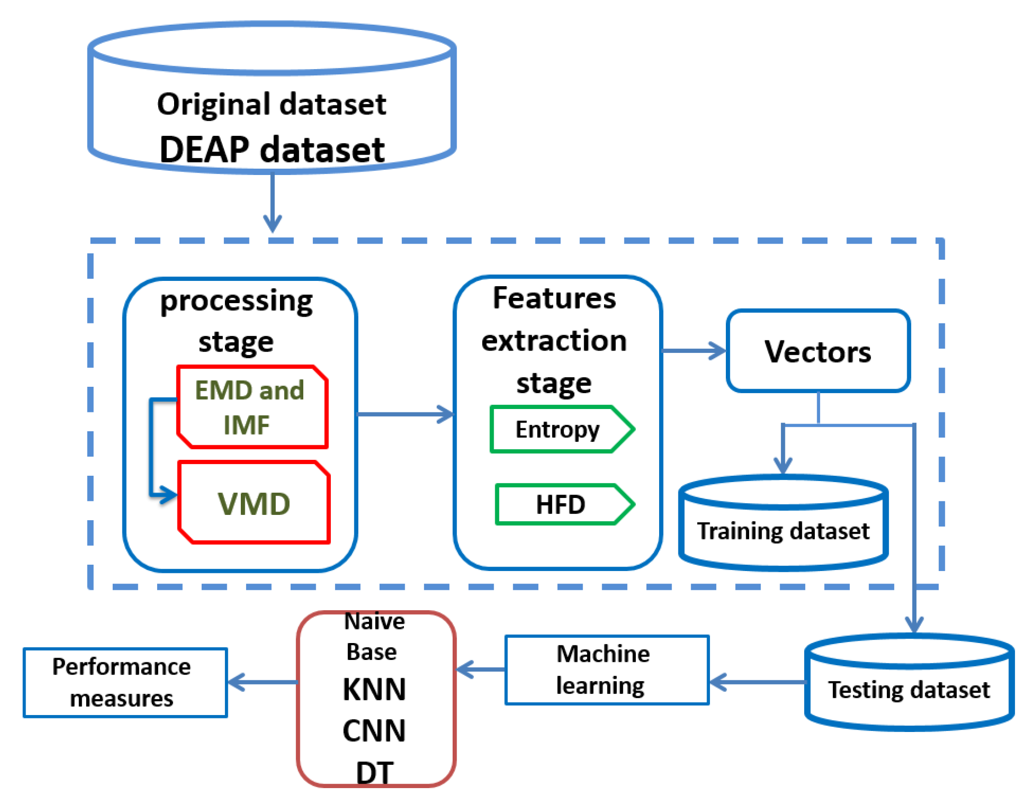
Proposed work

Slide 21
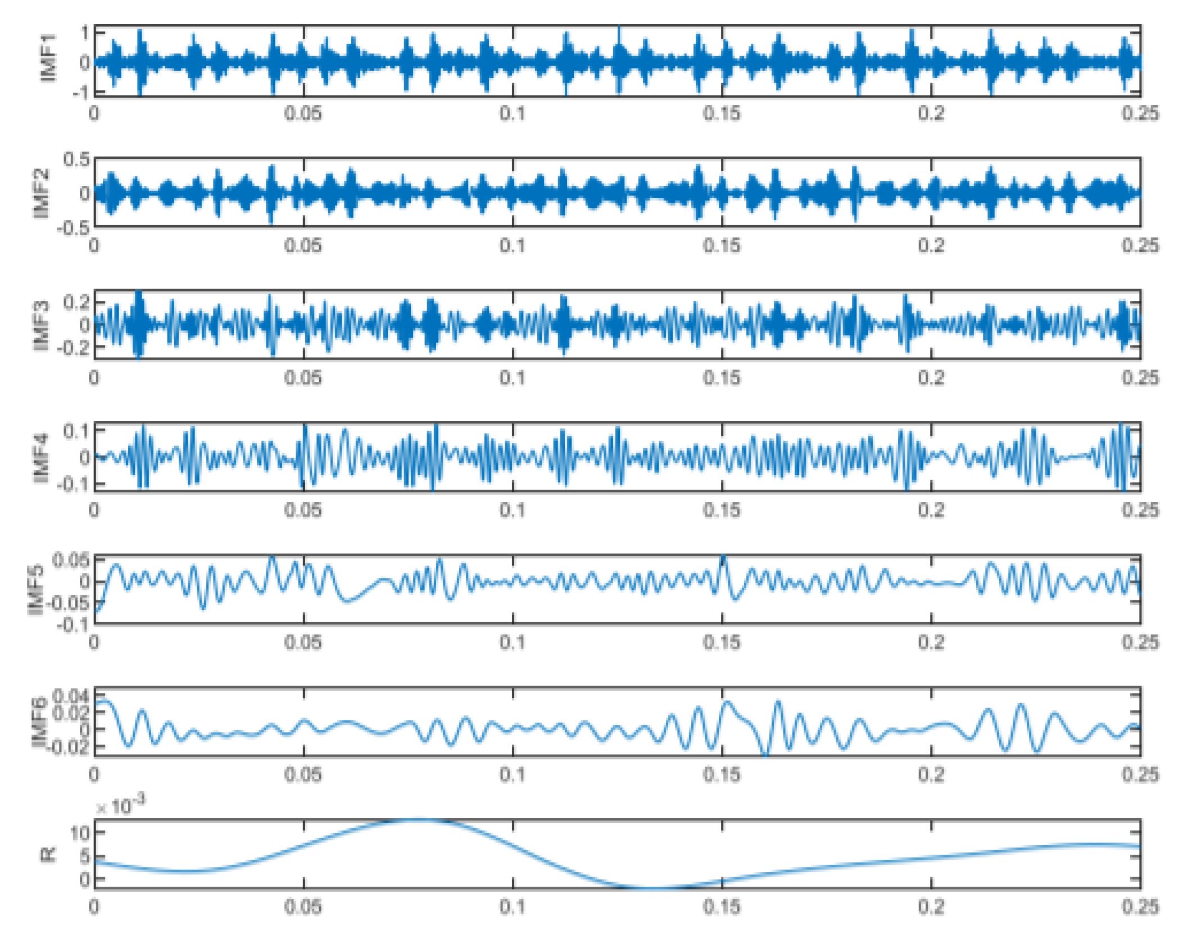
Experiment Tests
Denoised Signals

Slide 22
Conclusions
The evolution in the creation of sensors and signal record devices, as well as the development of signal handling and feature extraction techniques, has increased opportunities for using signals extracted from human organs, such as brain signals or heart signals, to identify a person’s condition, and thus detect psychological or pathological conditions in humans. This made the task of classifying signals required for improving the productivity of performance in the categorization of cases based on signals.
Categorizing emotions based on EEG signals could be one of the most complex applications with regard to analyzing human actions. This type of application can be defined as determining a person’s emotional state, which could reflect particular problems. EEG data can be extracted using different systems or devices. In this study, a DEAP dataset was used to identify and classify human emotions.

Slide 23
Thank You

